Slide 1

Presentation 1
Student ID : 1705087
Student ID : 1705089
Student ID : 1705080

Slide 2
Topics
How to do important configurations
Usage of default helpers
Overview and workflow of default wifi MAC layer

Slide 3
Objective
How to simulate a Wi-Fi topology in ns3 and what concepts should be kept in mind ..

Slide 4
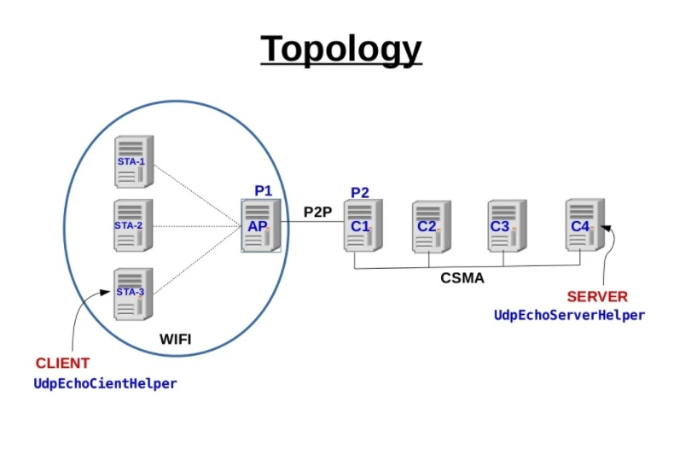
Topology

Slide 5
Topology Desription
Channels & Net Device
Wireless
Point to Point
CSMA
Node Container
Access Point Node
Station Nodes
Point to Point Nodes
CSMA Nodes

Slide 6
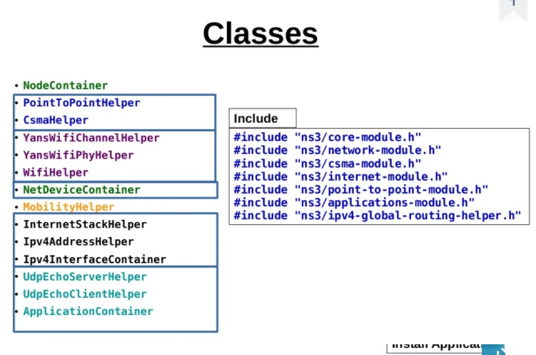
Classes

Slide 7
Basic Components
Basic components
Nodes
Net Device
Channels
Application
Protocol Stack

Slide 8
Main Program Structure
Include HEADER Files
Include NAMESPACE
Enable/disable LOGGING
Create NODE
Configure TOPOLOGY for Nodes
Set up INTERNET STACK
Set up APPLICATION
Run SIMULATION

Slide 9
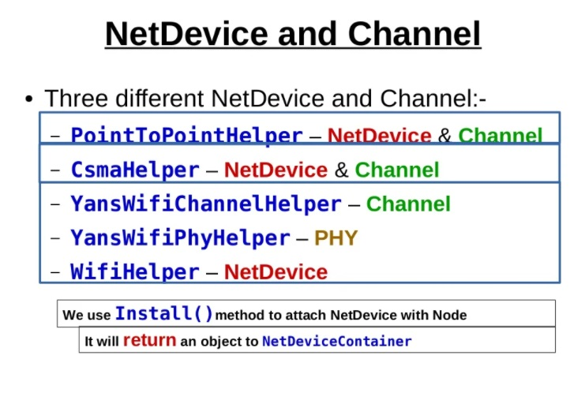
NetDevice & Channel

Slide 10
Ns3 Helper
A simulation program which is written entirely using the low-level API(Application Programming Interface) would be quite long and tedious to code.
For this reason, a separate “helper API” has been overlaid on the core ns-3 API.

Slide 11
Why Ns3 Helper ?
Helper API makes heavy use of containers of similar objects to which similar or identical operations can be performed.
Ns-3 users may not need to worry about any low-level Object Create or Pointer handling. It can be done with containers of objects and stack-allocated helpers that operate on them.
Helper API is really all about making Ns-3 programs easier to write , read and configure without taking away the power of the low-level interface.

Slide 12
Some Ns3 Helpers
YansWifiChannelHelper
YansWifiPhyHelper
WifiMacHelper
WifiHelper

Slide 13

YansWifiChannel

Slide 14
YansWifi Channel
YANS is short for "Yet Another Network Simulator".
Helper can be used to create a Wifi Channel
YansWifiChannelHelper implements the propagation model described in Yans.
Some Channel related attributes :
Channel switch delay
Energy of received signal

Slide 15
What is propagation modelling?
Propagation modeling is an effort to predict what happens to signals in a route while going from the transmitter to the receiver.
The signal gets weaker and other signal impairments such as multipath fading can happen.
A propagation model is basically a path-loss calculation.

Slide 16
Types of propagation modelling for YansWifi Channel
There are two types of propagation modeling :
I. PropagationLossModel:
As a radio signal leaves the transmitter antenna, it undergoes a phenomenon known as Free Space Path Loss (FSPL) or Path Loss.Propagation loss models calculate the Rx signal power considering the Tx signal power and the mutual Rx and Tx antennas positions.
II. PropagationDelayModel:
Propagation delay is a measure of the time required for a signal to propagate from one end of the circuit to the other.It is limited by the speed of light.

Slide 17
YansWifi ChannelHelper cont..
YansWifiChannelHelper can be used to create a YansWifiChannel with a default PropagationLoss and PropagationDelay model.
The default is a channel model with a propagation delay equal to a constant , the speed of light
YansWifiChannelHelper wifiChannelHelper = YansWifiChannelHelper::Default (); Ptr<Channel> wifiChannel = wifiChannelHelper.Create ();

Slide 18
YansWifi ChannelHelper cont..
To configure YansWifiChannelHelper :
YansWifiChannelHelper::AddPropagationLoss
adds a PropagationLossModel; if one or more PropagationLossModels already exist, the new model is chained to the end.
YansWifiChannelHelper::SetPropagationDelay sets a PropagationDelayModel (not chainable).

Slide 19
YansWifiPhy

Slide 20
YansWifiPhy
YANS is short for "Yet Another Network Simulator".
As like before , This PHY model depends on a channel loss and delay model as provided by the ns3::PropagationLossModel and ns3::PropagationDelayModel classes, both of which are members of the ns3::YansWifiChannel class.

Slide 21
YansWifi PhyHelper
Configures an object factory to create instances of a YansWifiPhy.
Adds some other objects to it , such as a supplemental ErrorRateModel and a pointer to a MobilityModel.

Slide 22
ErrorRate Model
Models the error rate for different modulations.
A packet of interest is divided into chunks. For each chunk, it calculates the ratio between received power of packet of interest and summation of noise and interfering power of all the other incoming packets. Then, it will calculate the success rate of the chunk. The success reception rate of the packet is derived from the success rate of all chunks.

Slide 23
ErrorRate Model
Default YansWifiPhyHelper is configured with TableBasedErrorRateMode.
The error rate model can be changed by calling the YansWifiPhyHelper::SetErrorRateModel method.
YansWifiPhyHelper wifiPhyHelper; wifiPhyHelper.SetChannel (wifiChannel);

Slide 24
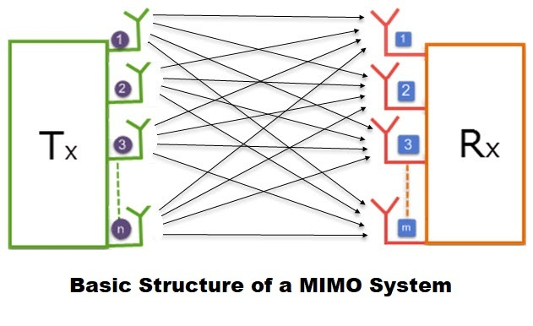
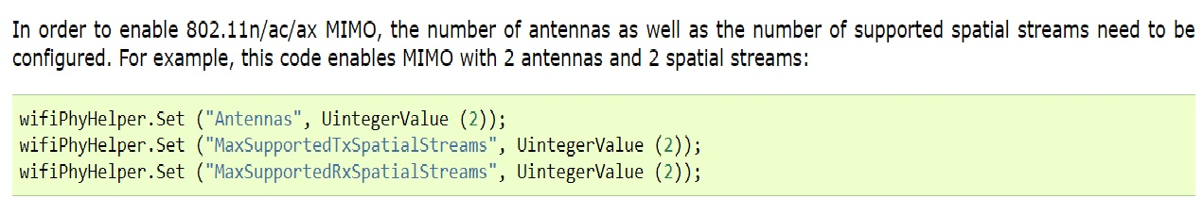
Mimo in YansWifi PhyHelper
Mimo is short from of multiple input multiple output . Mimo is a method for multiplying the capacity of a radio link using multiple transmission and receiving with help of spatial multiplexing

Slide 25
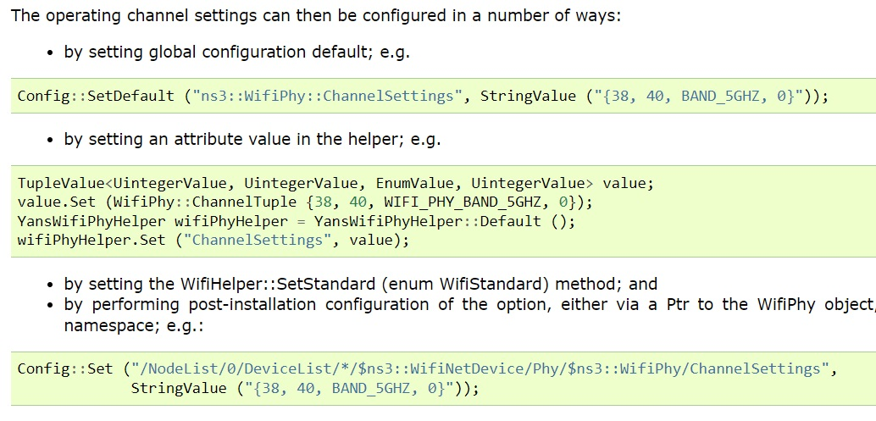
Channel Settings in YansWifi PhyHelper
There is a unique attribute named channel setting that enable to set
- channel number
- channel width
- frequency band

Slide 26
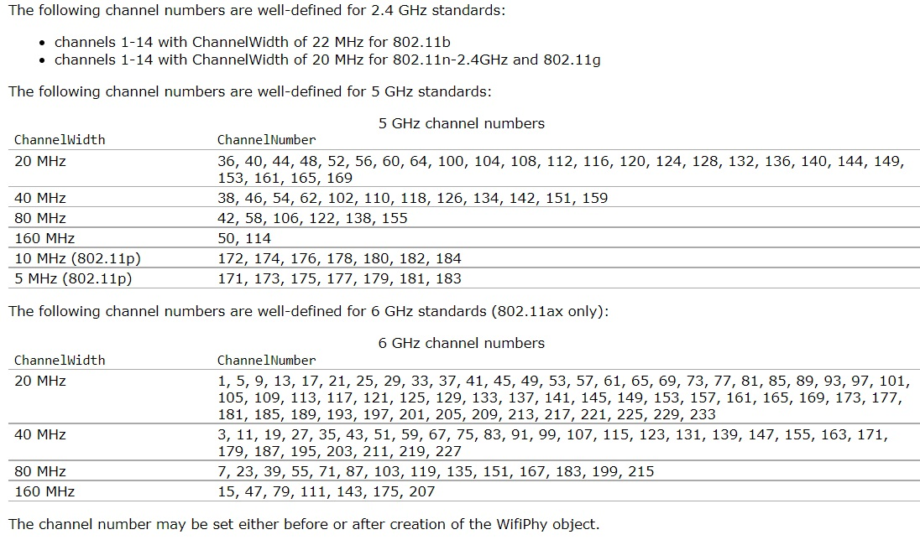
Channel Settings in YansWifi PhyHelper
These unique attributes (channel number
, channel width , frequency band etc ) which
can be set separately
However, valid channel numbers vary by geographical region
around the world, and there is some overlap between the different
standards

Slide 27
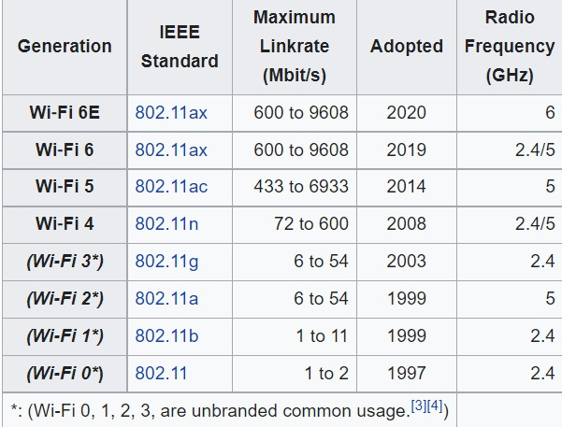
Standard in YansWifi PhyHelper
WifiHelper ::SetStandard (WIFI_STANDARD_ IEEE stand )
is a method required to set various parameters in the Mac and Phy to standard values , but also to check avaibility that the channel settings as described above

Slide 28
Mobility Model
Ns3 supports a set of mobility models which are used to track and maintain the current cartesian position and speed of an object.
It is used to track and maintain
- (cartesian) coordinate system
- speed of an object
- placement of node
- setup mobility model.

Slide 29
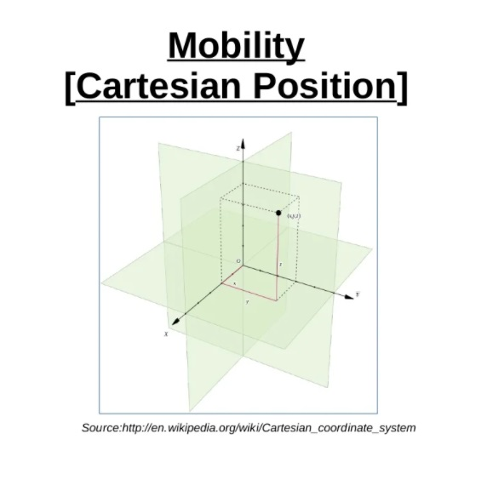
MobilityModel

Slide 30
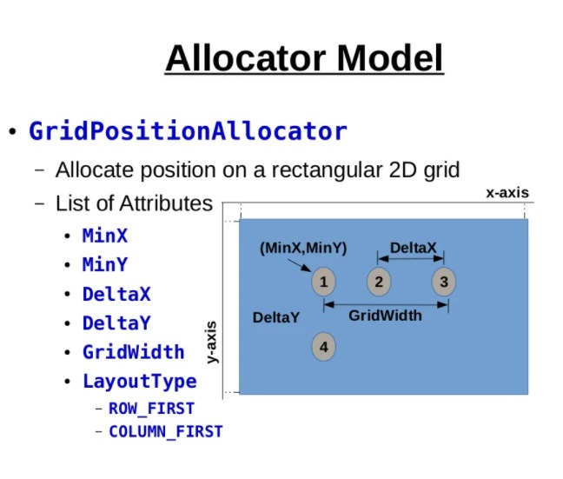
Mobility Model

Slide 31
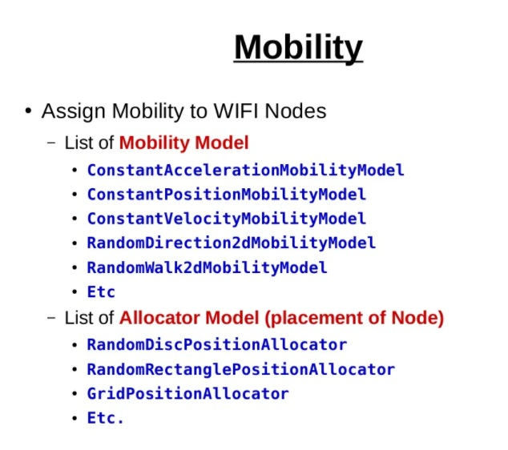
Example of Mobility Model

Slide 32
WifiMacHelper

Slide 33
WifiMac Helper
Create MAC layers for a ns3::WifiNetDevice.
Can create MACs of type ns3::adhocWifiMac. Its purpose is to allow a WifiHelper to configure and install WifiMacc objects on a collection of nodes.
It offers the opportunity to configure attribute values away from their default values, on a per-NodeContainer basis.
By default, it creates an Adhoc MAC layer without QoS(Quality of Service; is a set of technologies that work on a network to guarantee its ability to dependably run high-priority applications and traffic under limited network capacity).
Typically, it is used to set type and attribute values, then hand this object over to the WifiHelper that finishes the job of installing.
WifiMacHelper takes care of both the MAC low model and MAC high mode

Slide 34
WifiMac Helper
To create ad-hoc MAC instances,
WifiMacHelper wifiMacHelper; Ssid ssid = Ssid ("ns-3-ssid"); wifiMacHelper.SetType ("ns3::AdhocWifiMac", "Ssid", SsidValue (ssid), "ActiveProbing", BooleanValue (false));
create an AP with QoS enabled,
similarly create non AP static nodes
WifiMacHelper wifiMacHelper; Ssid ssid = Ssid ("ns-3-ssid"); wifiMacHelper.SetType ("ns3::ApWifiMac", "Ssid", SsidValue (ssid), "QosSupported", BooleanValue (true), "BeaconGeneration", BooleanValue (true), "BeaconInterval", TimeValue (Seconds (2.5)));

Slide 35
WifiHelper

Slide 36
WifiHelper
Sets the default wifi standard to 802.11a and sets the RemoteStationManager(hold a list of per-remote-station state) to ns3::ArfWifiManager.
the RemoteStationManager can be changed by calling the WifiHelper::SetRemoteStationManager method.
To change the wifi standard (set of services and protocols that dictate how a Wi-Fi network acts), call the WifiHelper::SetStandard method with the desired standard

Slide 37
WifiHelper
This creates the WifiNetDevice which includes also a WifiRemoteStationManager, a WifiMac, and a WifiPhy (connected to the matching Channel),
The WifiHelper::SetStandard method sets various default timing parameters as defined in the selected standard version, overwriting values that may exist or have been previously configured.
NetDeviceContainer wifiContainer = WifiHelper::Install (wifiPhyHelper, wifiMacHelper, c);
WifiHelper wifi; wifi.SetStandard (WIFI_STANDARD_80211n);

Slide 38
MAC Layer Introduction
MAC, or Media Access Control, is an important sub-layer of OSI Layer 2 – the Data Link Layer.
Main function: control access to a shared communication medium through which devices are connected.
E.g. For Wi-Fi, the medium is air.
Abstracts: the PHY layer (L1) to LLC sublayer & the upper layers (L2.5-L7)
Upper 5 Layers
Logical Link Control (LLC)
Layer 2
Data Link Layer
Media Access Control (MAC)
PHY Layer
The 7 OSI Model Layers

Slide 39
IEE 802.11(WiFi) Mac Layer
Or, widely known as the WiFi standard
Basic Responsibilities
Frame Management
&
Data Transfer
Unique Addressing
Control Access of
Transmission Medium
Create frame by adding headers.
Adding useful attributes to the header & maintaining them.
Transparent data transfer from LLC to PHY.
Assign unique addresses to each net device.
Use this address for MAC filtering & data transfer.
Control access to PHY medium.
Ensure errorless transmission.
Enables multiple user medium sharing.
CSMA/CD, CSMA/CA
R1
R2
R3

Slide 40
IEEE 802.11 MAC Layer Frame Management
R1
MAC Layer data are called frames.
It takes a packet of data called MAC Service Data Unit (MSDU) from LLC sub-layer.
Necessary header and tail bytes are added to form MAC Protocol Data Unit (MPDU).
MPDU is then sent to the PHY layer for transmission.
The reverse flow happens when MAC receives a packet from physical layer.
LLC Sublayer packet
MPDU
MSDU
MAC Layer Frame

Slide 41
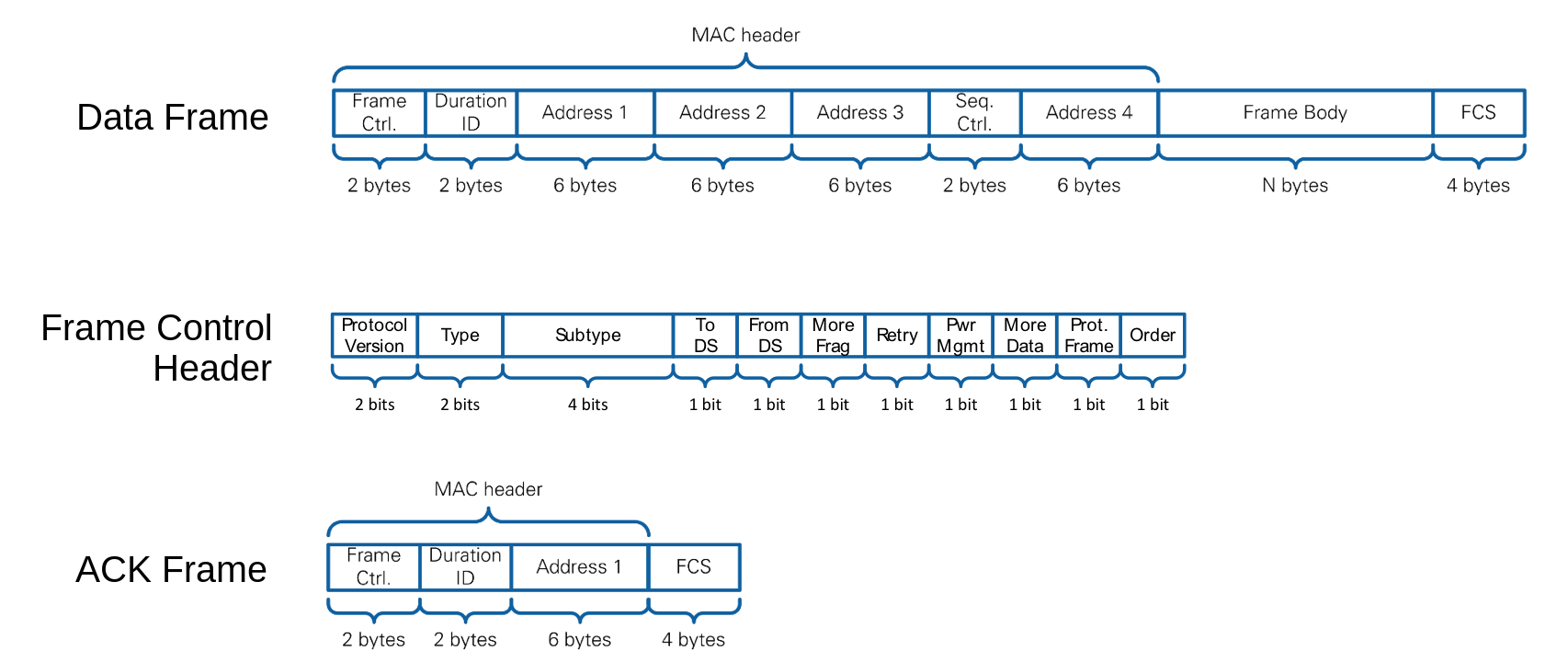
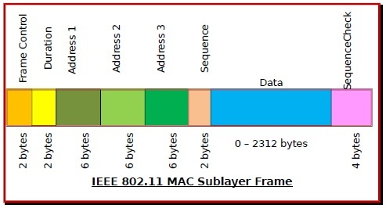
IEEE 802.11 MAC Layer Frames Breakdown
R1
MAC Sublayer Frame Breakdown
MAC Sublayer Frame Types

Slide 42
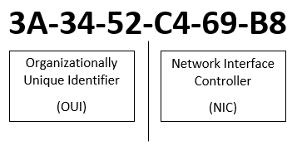
IEEE 802.11 MAC Layer Addressing Mechanism
R2
Called MAC Address
unique serial number.
Typically assigned to network interface hardware (NIC) at the time of manufacture.
based on early Ethernet addressing scheme
48-bit
Example

Slide 43
IEEE 802.11 MAC Layer Access Control Mechanism
R3
What? Control access to the physical medium (e.g. bus, ring, hub, wireless networks)
Why? Several stations connected to the same physical medium, must share it.
Benefits?
Sharing of channel
Detect & Avoid data packet collision
Ensure errorless transmission
Mechanisms currently used: Point Coordination Function (PCF) or Distributed Coordination Function (DCF). DCF employs Carrier Sense Multiple Access with Collision Avoidance (CSMA/CA) method.

Slide 44
MAC Layer Implementation In NS3

Slide 45
WifiMac Model Sublayers
Majorly Can be divided into 2 sublayers:
MAC Low Models:
medium access (DCF and EDCA)
frame protection (RTS/CTS)
acknowledgment (ACK/BlockAck)
Frame Exchange Manager
MAC High Models:
MAC-level beacon generation, probing, and association
a set of Rate control algorithms.
More software-oriented implementation
Pseudo MAC Middle:
Channel Access Manager
In files:
ns3::WifiMac, ns3::ApWifiMac, ns3::StaWifiMac, ns3::AdhocWifiMac
ns3::FrameExchangeManager, ns3::ChannelAccessManager, ns3::TxOp

Slide 46
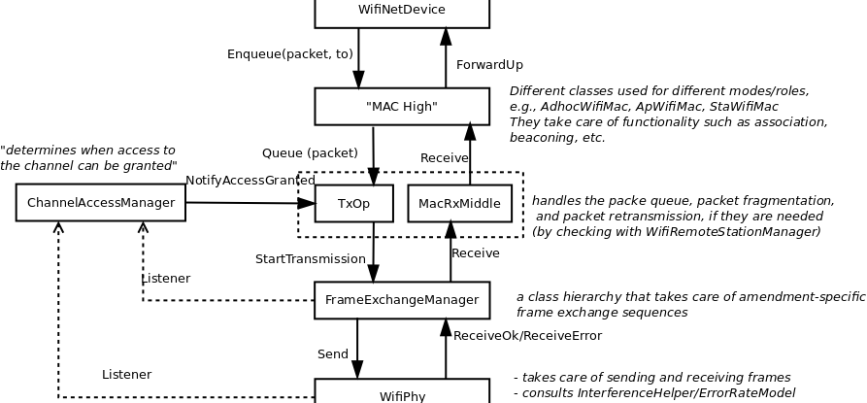
WifiMac Model Architecture

Slide 47
WifiMac Model Architecture

Slide 48
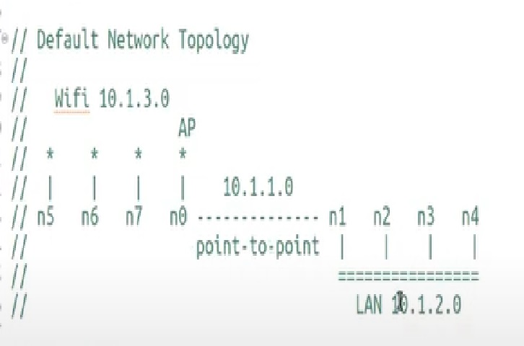
Example Code : Topology

Slide 49
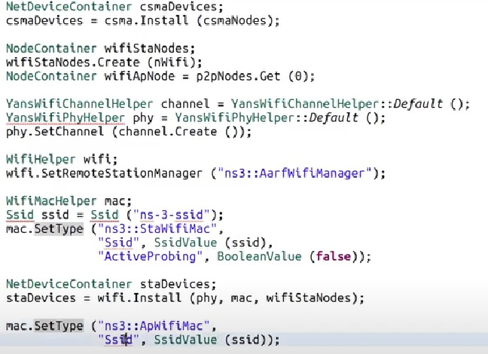
Example Code : Topology

Slide 50
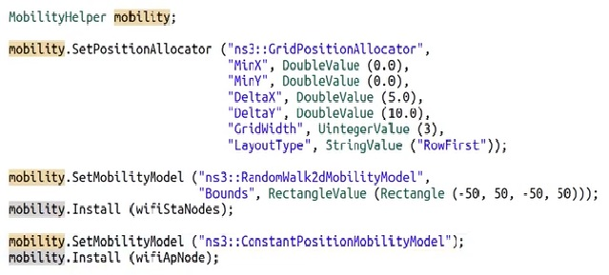
Example Code : Topology

Slide 51

Thank You

